Slide 1

Argentina Politics, Economy and Current Events
SEPTEMBER 10 - 13th , 2014
Private Vineyards Owners’ Conference

Slide 2

Remember
No One Knows ANYTHING

Slide 3
Summary
Inflation
Devaluation
Politics
Default
The Future

Slide 4
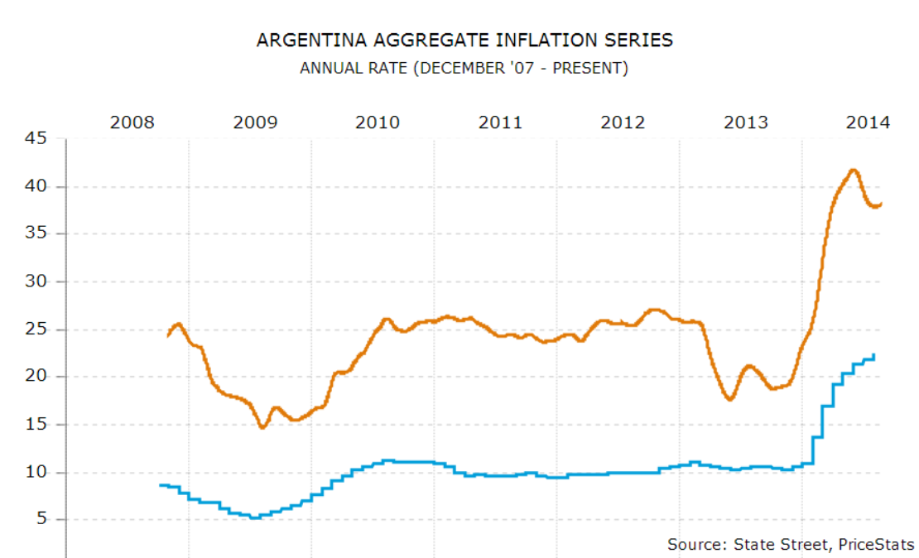
Inflation

Slide 5
Real Inflation

Slide 6
Devaluation

Slide 7
Politics
The Kirchner Regime
  Nestor: May ’03 - Dec ’07
  Christina: Dec ‘07 – Oct ’15
The Next Regime
  Macri, Massa, Scioli
Notes:
Critics of Kirchner's administration charged it with corruption, crony capitalism, falsification of public statistics, harassment of Argentina's independent media and use of the tax agency as a censorship tool

Slide 8
Default
2001 was a major default
Argentina was forced into the 2014 default
Argentina exploring strategies to pay restructured lenders

