Slide 1
Growing Grapes in Argentina
SEPTEMBER 10 - 13th , 2014
Private Vineyards Owners’ Conference
Notes:
I NEED AN AGENDA

Slide 2
Growing Grapes in Argentina
AGENDA
Winegrape Growing Overview
Your Vineyard: Technical & Economic aspects
What do we do?
Notes:
I will show what happens in your vineyard not only from a technical point of views, but also with from a business perspective. . (or why the hell I am loosing money every year)
And also, I found this an important opportunity to tell you show you that it is very important for me personally keep the costs down.
- We are going to through all the factors that impacts on the farming costs and Revenues and what are we actually doing in order to help you to have a healthier agricultural business.

Slide 3
Farming Costs
Notes:
During the history of the grape business in Argentina, we can find periods of time where growing grapes was an extraordinary business, and some others where the low profitability forced many wineries and vineyards to close thier Doors or had to reconvert their quality or products. We can see here that we had gone through a great moment (the 90s) where the revenues exceded in 80’90% the famring costs. In 2013 our currency was devaluated against Dollar, which caused a stop in the increase of the farming costs. The planted acres are decreasing every year and consequently there will be a moment soon, when demand is higher than the supply, grape price will raise.
Wineries are producing themeselves the super premium grapes. They have enough prodcution to handle the source the wine market. Export trends shows that the volume (60 US$ a case and below ) in decreasing but the high end wines are increasing the demand.

Slide 4
Growing Grapes in Argentina
Notes:
Direct Labor represent the biggest portion of the costs in every region.
Napa has the Highest proportion in direct labor expenses, Due to $/hour , not the hours/acre
In Uco Valley we spray less than half of the times compared to France, but our agrochemicals are more expensive than theirs.

Slide 5
Direct Labor
Grape Production Costs
Grape Growing Business
Notes:
In general terms we see that there is little difference in the proportions of usage hours between SP and P except for canopy management.
Canopy Management represents almost 60% of all hours spent. and the difference between SP and P is given primarily by a task named Shoot Thinning and Leaf Thinning.
Richard Saperstein. It took him almost 2 hours to complete almost half a row. Right? Haha. that represent 4 hours per row.. And lot 10 has around average 24 rows per acre ‘ this means almost 100 hours. !!
Harvest premium consume more hours than super premium, because it is directly proportional to the amount of grapes.
One thing to bear in mind is that the consumption of these hours is pretty concentrated in the months of (CHANGE SLIDE) December and January.

Slide 6
Direct Labor
Grape Growing Business
$ 5.6
Notes:
We’ve been suffering a constant increase of the labor costs durinf this period. High inflation and dólar price stabilized. Noe with the devaluations of the ARG pesos we expect that the curve gets flat.

Slide 7
Direct Labor
A - GRAPE PRODUCTION COSTS Direct Labor Services
Grape Growing Business
Notes:
I hace to say here that we are reallly focus on being more efficient every year.
It is surprisingly easy to spend more hours than the predicted ones. The whole team is thinking on this. Actally their bonuses are directly related to the savings.
We are not only focus on getting efficent on Labor costs, we are also thinking on the rest of the expenses that have to face while farming. Argrchemicals and Supplies are the 2nd most important expense we have and the braekdown is . Change Slide.

Slide 8
Manual Harvest Video.
Grape Growing Business
Notes:
Picked 122 bins - 1525 kilograms - 18 real harvesters - 43 minutes THAT WAS FAST. , they knew that Michael was filming them, that was an exptional productivity.
In a day of 8 hours… 17,023 kilograms. This is equivalent to 945 kilograms per person / day. Or…. 119 kilograms per person per hour.

Slide 9
Machine Harvest Video.
Grape Growing Business
Notes:
Those machines picked 502.3 kilograms from 193.2 lineal meters in 69 seconds.
In 8 hours (discounting dowtime which is 15 minutes every 2000 kilograms per machine)
137,500 kilograms/day - 68,750 kilograms per day / machine. - 8593 kilogram/ hour per machine.

Slide 10
Machine Harvest: 8593 kgs / hour Manual Harvest: 119 kgs / hour
Grape Growing Business
Notes:
CALCULATE COST – HOUR
Those machines picked 502.3 kilograms from 193.2 lineal meters in 69 seconds.
In 8 hours (discounting dowtime which is 15 minutes every 2000 kilograms per machine)
137,500 kilograms/day - 68,750 kilograms per day / machine. - 8593 kilogram/ hour per machine.

Slide 11
Agrochemicals & Supplies
Grape Growing Business
Notes:
This chart shows the breakdown fo the agrochemicals that we use in your vineyard. Fungicides against milduew ( 2014 exceptional use because of rain) Pesticide Ants mainly. Fertilizer to keep the plant in a proper nutritinal condition, the Herbicide to kill weeds located in hte planting line or planting band y Fuel to keep the tractors in movements.
These last 2 supplies has no direct impact on quality and quantity. FUN PES FER yes. We don{t want to compromise the vineyard by restricting FPFer, because those agrochemicals impacts directly in the revenue by affecting quality and quantity of grapes. So we´ll focus our attention in herbicides and fuel.

Slide 12
Machine Harvest: 8593 kgs / hour Manual Harvest: 119 kgs / hour Wine Camps..… 23 kgs / hour
Grape Growing Business
Notes:
Those machines picked 502.3 kilograms from 193.2 lineal meters in 69 seconds.
In 8 hours (discounting dowtime which is 15 minutes every 2000 kilograms per machine)
137,500 kilograms/day - 68,750 kilograms per day / machine. - 8593 kilogram/ hour per machine.

Slide 13
Grape Growing Business
U$S 0.225/kg
U$S 0.091/kg
U$S 0.045/kg
Notes:
Here it is interesting to see where it starts making sense using the machines to harvest the grapes.
This chart is showing that in those vineyards yielding above 25 hundred kilos an acre, the use of the machine to pick grapes makes more sense economically. The cost to pick a kilogram dicreases with the increasing production. At 5 tons/acre machine harvest costs 50% copared to Manual. And at 1 tn/acre it is 2 and a half times more expensive.

Slide 14
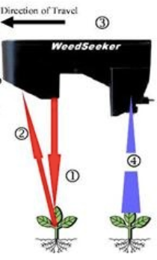
Grape Growing Business
Herbicide
LEDs projects infrared light
Light reflected and captured
Sensors decode reflected light
Detection and Spray the weed
Notes:
this equipment ´prejects a persistent infrared light towards the soil, in the planting row. At the very end there is a sensor that captures the reflexion of that infrared light, and when the reflection comes from a green object (Weed) that signal is decoded and sends the signal to the emiter to open it and spray the weed
• Save on overall weed control costs
• Reduce chemical usage by applying precisely and in low amounts
• Reduce the environmental impact of your field activities
• Cut down on time and labor

Slide 15
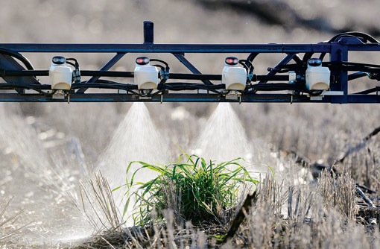
Grape Growing Business
Notes:
Here we can see claerly how this weed seeker works. Only when the sensor detects a green reflection the weed seeker spray the weeds. The 2 sensors in each side of the structure are not spraying, and there is where the savings starts.
Thanks to this new technology, we would be able to reduce 80% the application of herbicide. CHANGE SLIDE

Slide 16
Herbicide
Grape Growing Business
4-6 applications per year
1.05 l/acre per application
U$S 55.2 / acre / year
Notes:
AS many fo you should know already, we use herbicide to elimiante the weeds that are close to the planting band, in order to set the plants free from competition. The weeds consume the water and nutrients scheduled to feed the vines, causing a weaker growth of the vine.
We have been applying 1 liter / acre of herbicide per application. Which can vary from 4 to 6 in a season. So we are cuurrently spending around 5 liters of herbicide per acre per year

Slide 17
Herbicide
Grape Growing Business
4-6 applications per year
1.05 l/acre per application
U$S 55.2 / acre / year
Per year
U$S 11,07 / acre / year
Notes:
Moving the costs down to U$S 11.07 - acre.
BUT this is not really signifficant when we consider the environmental benefits of not sprying the floor with gliphosate. The Sustainable comision, which we are memeber since june 2014, suggests that we shouldnt be spending more than 2 liters per acre per year and with this weedseeker we would be able to keep the planting band free from weeds by spraying only 1 liter per acre / year

Slide 18
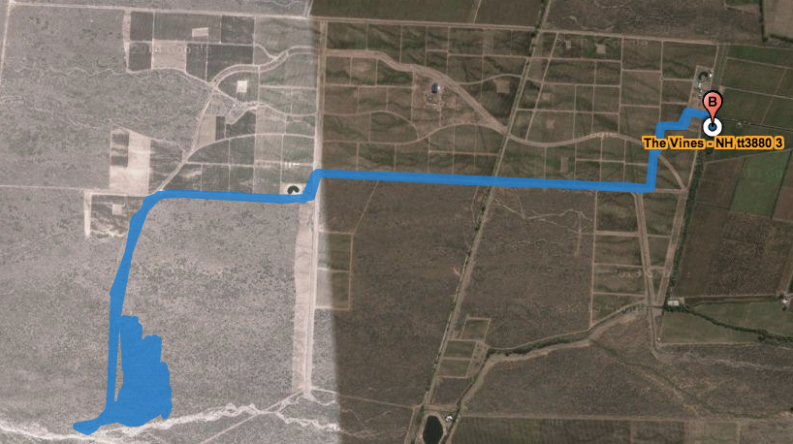
Grape Growing Business
S.A. #1
S.A. #2

Slide 19
Grape Growing Business
GPS data Tractor #3 - New Holland TT 3880
Parameters | From Service Area #1 | From Service Area #2
Engine ON – (hours) | 8.06 | 8.08
Trip – (hours) | 0.96 | 0.39
Vineyard – (hours) | 7.10 | 7.69
Area – (Acres) | 8.15 | 9.09
Fuel Consumed – (lts) | 23.1 | 23.3
Analysis | SA #1 | SA #2 | Difference | U$S annual savings
Fuel consumed / hour (lts) | 2.86 lts | 2.88 lts | +0.02 lts / hour | N/A
Hours spent / acre | 0.98 hs | 0.88 hs | -0.1 = 6 minutes less | U$S 20,742.85
Fuel consumed / acre (lts) | 2.83 lts | 2.56 lts | -0.27 lts / acre | U$S 3,360.30

Slide 20
Revenues Yields – Grape Price – Quality (?)
Grape Growing Business

Slide 21
Grape Growing Business
YIELD
(kilograms / acre)
Terroir
Varietal
# of Vines / acre (lineal meters per acre)
Farming strategy - quality (?)

Slide 22
Grape Growing Business
Kg/acre (New Goal)
Kg/acre - Actual
Kg/acre (Original Goal)

Slide 23
Price
Grape Growing Business
Market - Export trends, Demand, Statistics (Volume vs $) an increasing demand for icon and ultra premium wines.
Varietal – Malbec vs Torrontes
Commercial Strategy – Partnerships – long / mid term deals.
Grape Quality (?) -

Slide 24
Wine export evolution by volume and U$S
Grape Growing Business

Slide 25
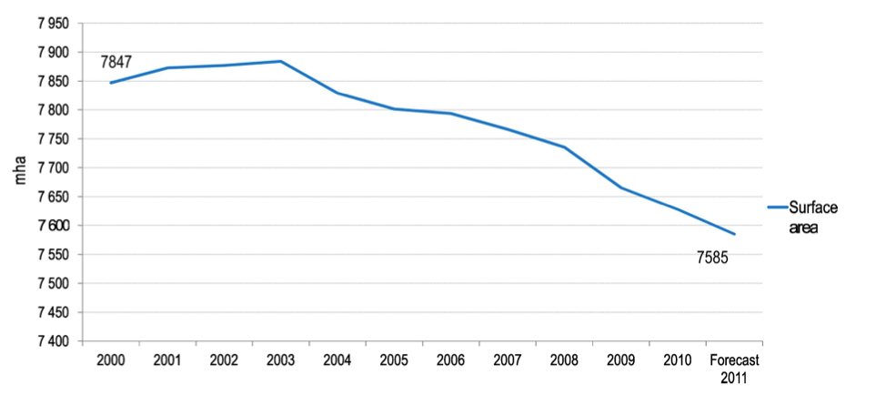
Grape Growing Business

Slide 26
Grape Growing Business
The Vines of Mendoza
Catena La Rural Chandon
Alta Vista Michelini Achaval
Clos de los 7 Flichman Trapiche
Cobos Norton Dona Paula
Ruca Malen

