Slide 1
The Vines of Mendoza
2013 Owners Conference
September 19, 2013

Slide 2
Goals for Owners Conference
Provide information to manage and enjoy your vineyard – and make better wines
Gather feedback to improve our CS, VM and WM
Opportunity for sharing and friendships among owners
Advance a framework for the commercialization of wines
Drink some great wines and have some fun

Slide 3
Agenda
Our Goals
About The Vines & the future
Private Vineyards
  About the Owners/Vineyards
  Farming & Winemaking Strategy
The Vines Resort & Spa
Winemakers Village
Owner Benefits
Key Challenges
Expanded Client Services
Path to Commercialization
Questions & Answers

Slide 4
The Vines – Our Primary Goal
Make the best possible quality wines with our owners

Slide 5
Additional Goals
Create amazing, personalized, wine experiences for our owners
Eliminate the headaches of vineyard ownership, winemaking and distribution
Create a learning environment where our owners can truly become winemakers
Create an efficient and cost-effective operation
Assist interested owners in selling their wines commercially
Create an excellent return for our investors

Slide 6
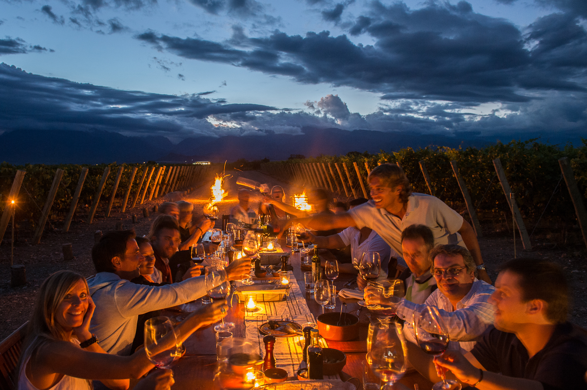
The Vines
The Vines of Mendoza is more than an extraordinary place. It’s a style of living and being. Rooted in the pleasures of making, drinking and sharing wine, The Vines immerses you in the delights of Argentine culture, natural beauty, and warm-hearted hospitality.

Slide 7
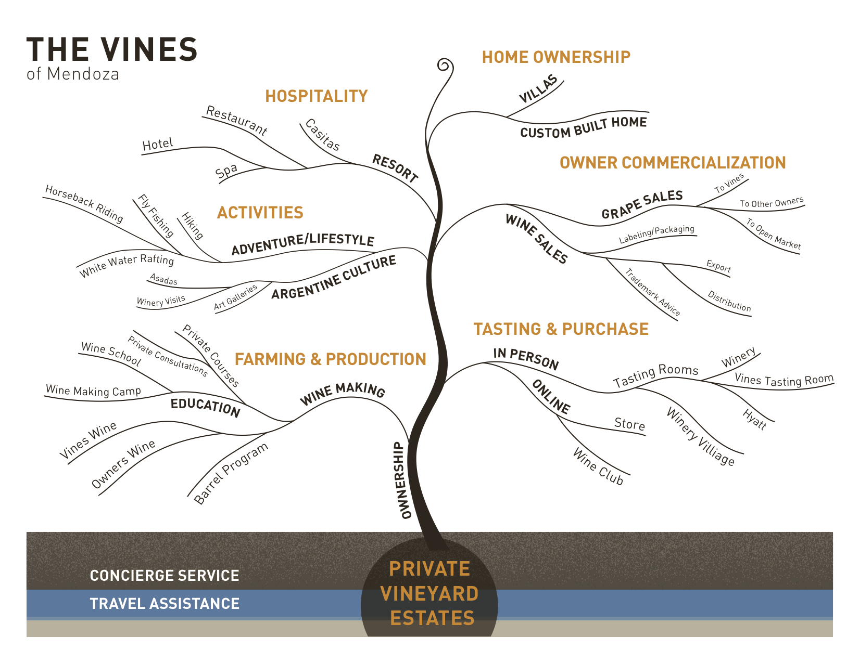

Slide 8
The Vines Today
150 amazing staff
127 Private Vineyard owners
360 fermentations in 2013
1,500 acres – 670 planted
The Vines Resort & Spa opens on Dec 31
Winemakers Village opens in 2014
Notes:
largest employer in Tunuyan

Slide 9
The Vines – The Future
Focus on efficiency, processes
95+ point wines
Greatest hotel in South America
Winemakers Village
Managed growth to 200 PV owners
Possible project in Europe

Slide 10
Corporate Structure
90 individual investors have contributed $10.2M in equity to grow the company
Board of Directors with 3 management representatives and 4 investor reps (3 of which are also PV owners)

Slide 11
PRIVATE
VINEYARDS

Slide 13
About our Private Vineyard Owners
127 owners from 13 countries
  71% North America
  17% Brazil
  8% Europe
  3% South & Central America
  1% Australia
Approximately 20 new PV owners per year
Average vineyard size is 5 acres (smallest is 1 and largest is 19 acres)

Slide 14
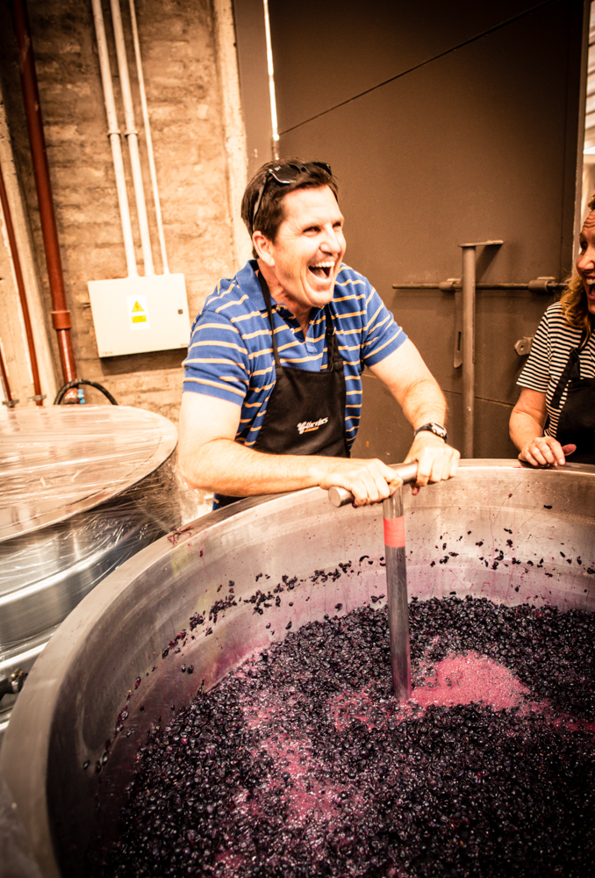
Owner Goals
78% - Personal enjoyment (no commercial intentions)
21% - Personal enjoyment and limited commercial desires (at least “break even)
6% - Commercial interest – PVs as a business

Slide 15
The Vineyards
670 acres planted through 2012 (18 different varietals)
100 additional acres will be planted in 2013 (including 3 new varietals - Carmenere, Sangiovese and Teroldego)
We have 190 acres available for future sale

Slide 17
Farming Strategy
Production for maximum quality, maximum revenue or somewhere in between
  Super Premium (<2,000 kg/acre)
  Premium (Plus) (2,000-3,000 kg/acre)
  Commercial (4,000+ kg/acre - max quantity and revenue)
Malbec grapes are worth 20-50% more than other varietals on the open market
The Vines is building a brand around our grapes, which should create premium prices
Regrafting is an option to change varietals

Slide 18
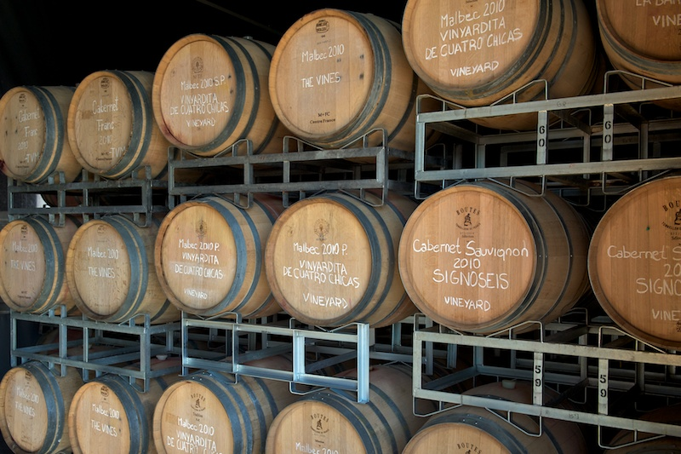
The Winery
360 fermentations in 2013!
Capacity is 290,000 liters plus the Gimenez Rilli winery for Recuerdo
We added a new building for barrel storage, bottling, blending sessions and admin
New bottling machine to enable greater QC, flexibility and cost control
New fermentation building as capacity is needed (2015)

Slide 22
Winemaking Strategy
Overall quality is exceeding expectations and improving each year
Blending pool provides flexibility
Winemaking opportunities from neighboring vineyards
Barrel fermentations are creating very interesting wines
Shared fermentations available to decrease costs
We are evaluating sparkling and late harvest options

Slide 23
The Vines Resort & Spa
22 one & two bedroom villas to open for New Years Eve!
  70,000 square feet of construction
  U$15M investment
Flying gym and massive spa (10,000 square feet)
  Running and biking trails through vineyard (2.5, 5 & 10k)
Siete Fuegos with Francis Mallmann to open on October 14
Rack rates from $400 to $1,700, based on season and villa size
8 villas have been sold to PV owners
50% off for PVE owners in 2014*

Slide 24
Winemakers Village
12 boutique wineries at the entrance to the Private Vineyards
Personal projects of Santiago Achaval, Marcelo Pelleriti & Pedro Aznar of Clos De Los Siete, the Michelini Brothers, Gimenez Riili and Alejandro Vigil of Catena
PV owners Revana, Rob Lawson and the Neelands (Solo Contigo)
The Vines market will offer picnic supplies, wine tasting, artisanal beers and fresh ice cream

Slide 25
Owner Benefits
50% off Resort rates in 2014
25% off Siete Fuegos & the Spa
50% off tastings & flights
33% off all wines in the online store

Slide 26
Key Challenges
Politics – Cristina
Argentine economy & inflation
Import restrictions – paper for labels, capsules, etc.
Utilities – access to power and water in Uco Valley
Byzantine liquor distribution laws
Security Zone Commission
Ley de Tierras
Notes:
Not clearly defined yet
The restrictions are threefold: 1) foreigners may not own more than 15% of all rural land in Argentina; 2) of that 15%, no more than 30% can be owned by foreign persons of the same nationality; and 3) no foreigner can own more than 2,500 acres total in any particular “zone.”
To potentially avoid both, we working with the City of Tunuyan and the Mayor in particular to have our projected declared “urban.”

Slide 27
Inflation & Costs
Farming is a cyclical business
Real inflation of 15% or more since 2009
As a result, many wineries are making less wine, depressing the market for grapes
The Vines has raised farming prices by 7% and winemaking by 6%
Devaluation of the Peso is accelerating and inevitable (Blue dollar)
Devaluation create opportunities for owners
Vineyard management can decrease your risk
Notes:
As a result of high costs and some excess inventory, the quantity of grape being sold in the market was only 30-40% of what it they been over the last 10 years.
There is an economic anomaly in Argentina today – prices are artificially high. Many items are just as costly as they are in the US – which means they are 4-6x more expensive than they were when I arrived 8 years ago. That doesn’t make economic sense and a correction is inevitable.
Today the Peso is trading at the official rate at approximately $5.44 and on the “blue” market at $8.75. The Peso devalued at 10.5% in the first half of 2013 and most experts expect that it will continue to devalue, outpacing inflation. We expect to see an official rate of more than $6 by the end of the year and we may reach $7 in 2014. Several analysts are predicting a faster and more dramatic correction – to $9-11.

Slide 28
Expanded Client Services
Document repository in the cloud
Regional meetings, tastings, blendings, etc.
More self service educational materials FAQs (wiki)
Opportunities to connect/communicate with other owners
Shared distribution and commercialization services
Shared storage (NY)

Slide 29
Paths to commercialization
Online stores for owners (collective or custom)
Assistance with brand launching, marketing, getting into restaurants and retailers, etc.
Sell wine in our Tasting Rooms
MHW vs. setting up distributorships (regional?)
Competitions/ratings

Slide 30
Miscellaneous
Advice on tax and estate planning
Legal issues if selling wines?
Pay bills in Pesos?

Slide 31
Q&A

Slide 32
Next Owners Conference
2014 in Rio de Janiero!

Slide 33
Thank you to all of our amazing owners and friends for making these dreams come true

